Slide 1
Soldering and Brazing
Lecture 12

Slide 2
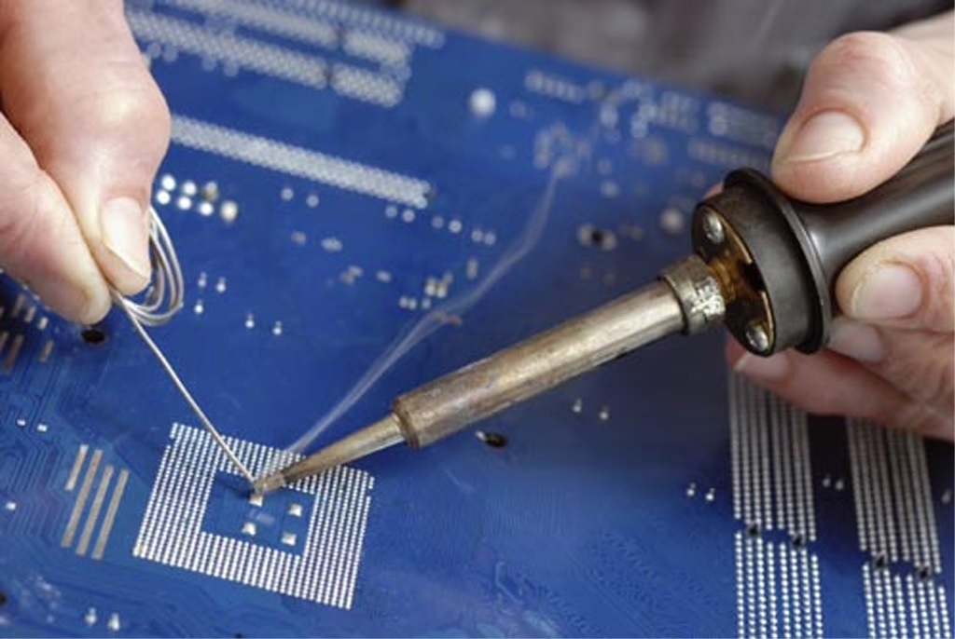
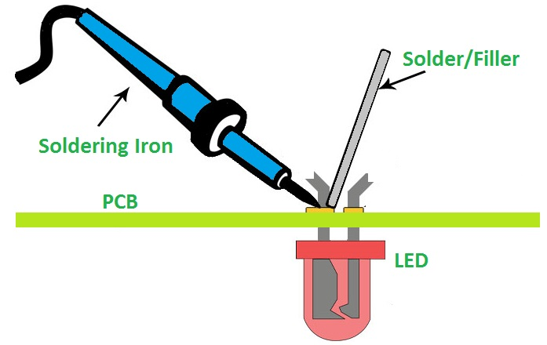
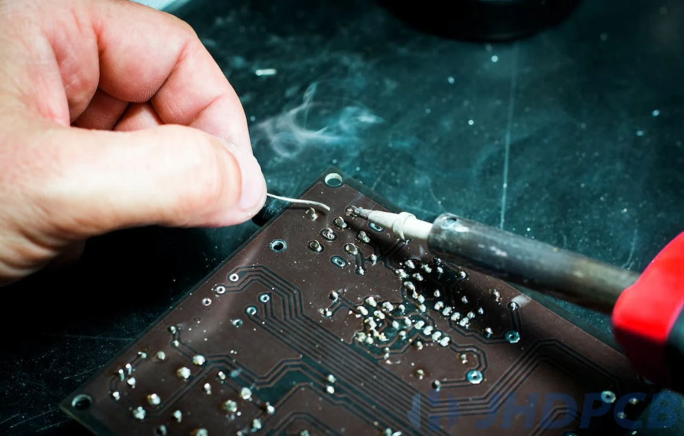
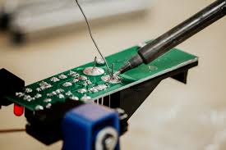
Soldering

Slide 3
Soldering
A method of uniting two thin metal pieces using a dissimilar metal or an alloy by the application of heat

Slide 4
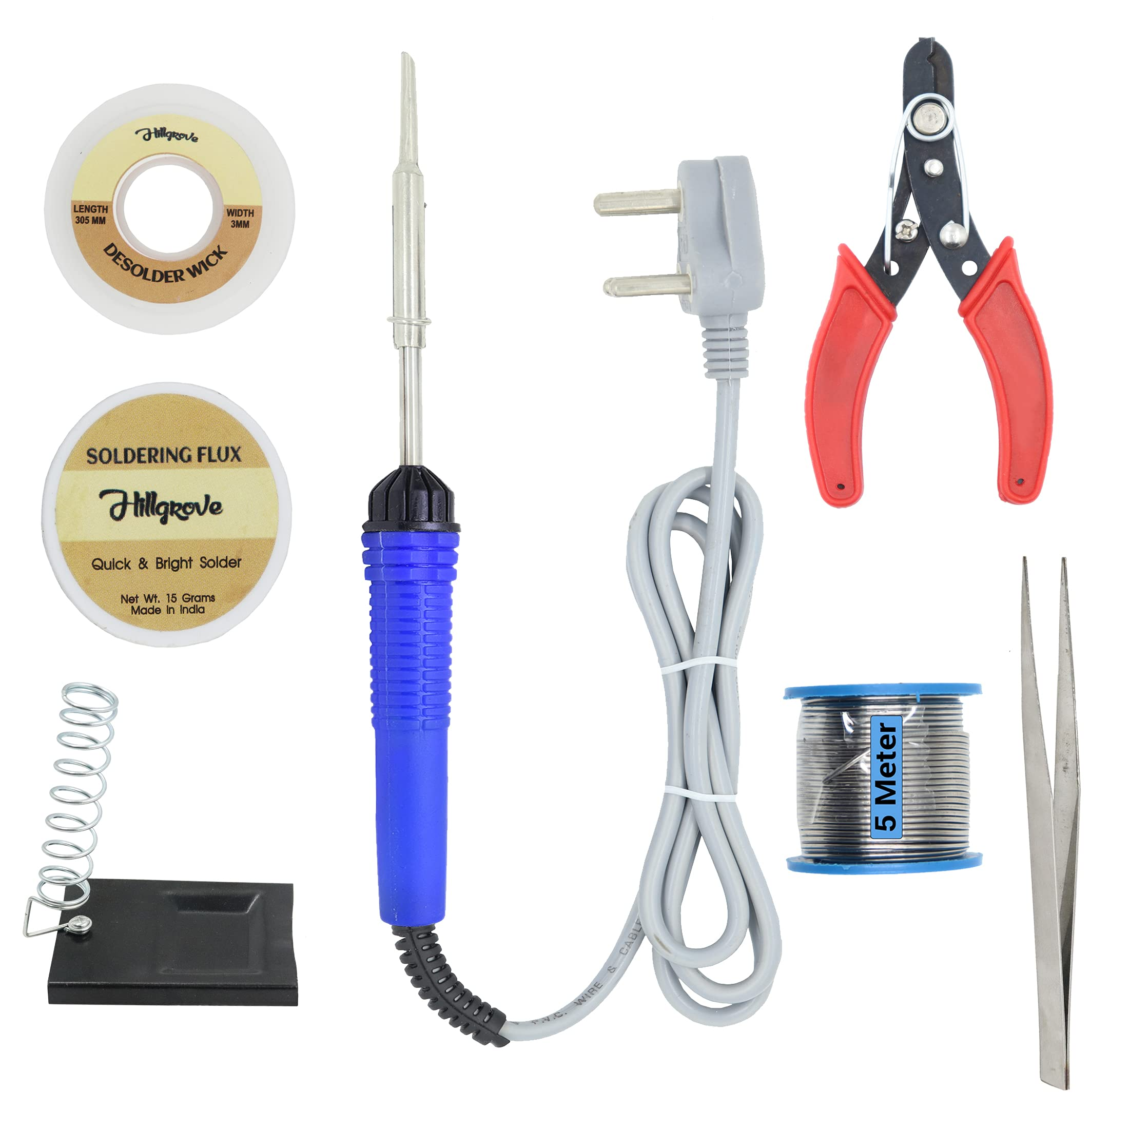
Soldering equipment

Slide 5
Soldering Equipment
Soldering Iron/Station: The heart of the operation, providing the heat to melt the solder. Soldering stations offer temperature control and can be more versatile.
Solder Wire: The fusible metal alloy that creates the bond.
Soldering Iron Stand: A safe place to rest the hot soldering iron when not in use.
Wet Sponge: Used to clean the soldering iron tip of excess solder and oxidation.
Desoldering Tools: Tools like desoldering wick or a solder sucker help remove excess solder or correct mistakes.

Slide 6
Soldering Types
Soft solder: Alloy of lead (37 %) and tin (63%)
Melting temperature, 150 – 350⁰C
Hard solder: Alloy of copper , tin and silver
Soldering temperature, 600 – 900⁰C
Used for stronger joints
Flux: Zinc Chloride
Clean the joint surfaces & to prevent oxidation

Slide 7
Soldering Process
1. Preparation:
Clean the surfaces: Ensure the metal surfaces to be joined are free from oil, dirt, or oxidation by cleaning them with a solvent, fine sandpaper, or steel wool.
Position components: Place the components or parts to be joined in their correct positions.
2. Apply Flux:
Clean and protect: Apply a flux pen or paste to the joint area. Flux removes any remaining oxide layers from the metal surfaces and prevents new ones from forming during heating, ensuring the solder will flow properly and create a good connection.
3. Heat the Joint:
Heat the joint not the solder: Touch the heated tip of the soldering iron to the surfaces to be joined for a few seconds to bring them to soldering temperature. The goal is to transfer heat to the metals so they can melt the solder.

Slide 8
Soldering Process
4. Apply Solder:
Melt the solder: While the joint remains hot, bring the solder wire into contact with the heated joint. The heat from the joint will melt the solder, not the iron.
Allow to flow: The molten solder will flow into the joint, forming a strong bond with the metal parts.
5. Finish the Joint:
Cool and solidify: Remove the iron and the solder wire and allow the joint to cool and solidify.
Clean the residue: Once cooled, use a damp sponge or cotton swab to clean any remaining flux residue from the connection

Slide 9
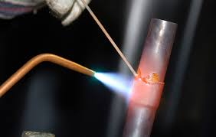
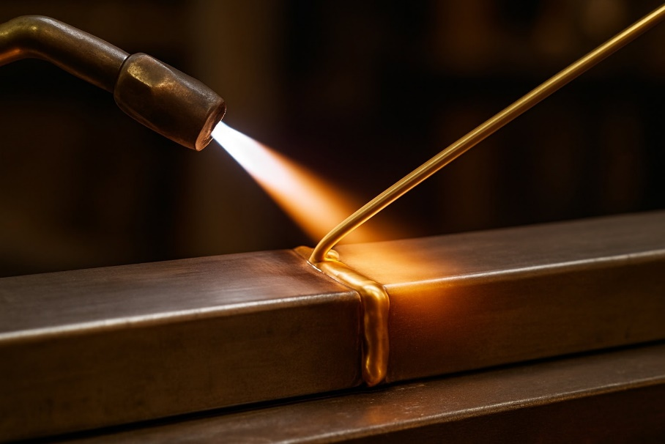
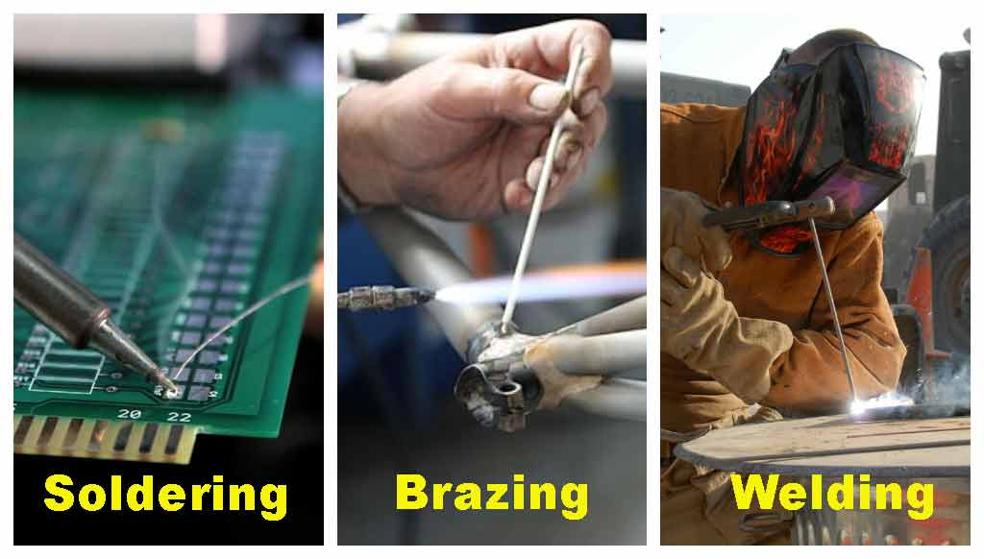
Brazing

Slide 10
Brazing
A method of joining two similar or dissimilar metals using a special fusible alloy.
Brazing temperature is the range above the solidus temperature (where the filler metal begins to melt) and below the melting points of the base metals being joined. Generally, this ranges from approximately 450°C (842°F) to 1200°C (2192°F).

Slide 11
Brazing Heat Sources (Types of Brazing)
Torch Brazing: Uses a torch, often oxy-acetylene or propane, to heat the joint.
Induction Brazing: Employs an induction coil to generate heat in the workpieces.
Furnace Brazing: Involves placing the assembly in a furnace to heat it evenly.
Resistance Brazing: Utilizes electrical resistance to create heat at the joint.

Slide 12
Brazing Equipment
Brazing Torch: A handheld tool for torch brazing.
Brazing Machine: Used in induction or resistance brazing processes.
Nozzle Set: Assorted nozzles for torches to control the flame.
Lighter/Spark Lighter: A spark lighter for igniting torches.
Gas Regulators & Hoses: For controlling the gas flow in an oxy-acetylene setup.
Personal Protective Equipment (PPE)
Brazing Goggles: To protect the eyes from sparks and fumes.
Welding Gloves: To shield hands from the heat and potential sparks.
Protective Clothing: Such as leather aprons to protect the body.

Slide 13
Brazing Process
1. Cleaning: Thoroughly clean the components to remove oxides, grease, and other contaminants, as they can cause weak or brittle joints.
2. Joint Design: Create a joint with a precise, small gap (typically 0.05-0.2 mm) to facilitate capillary action for the filler metal.
3. Fluxing: Apply a flux to prevent oxidation during heating and to promote wetting, allowing the filler metal to spread evenly.
4. Heating: Heat the assembled parts to a temperature just above the filler metal's melting point but below the melting point of the base metals.

Slide 14
Brazing Process
5. Applying Filler Metal: Introduce the filler metal into the joint. It will melt and be drawn into the gap between the base metals by capillary action.
6. Cooling: Allow the assembly to cool, which solidifies the filler metal and creates a permanent, metallurgical bond.
7. Post-Brazing: Clean any remaining flux residue from the joint.

Slide 15
Distinguish between brazing and soldering
Brazing | Soldering
Melting point of the filler material is above 450⁰C | Melting point of the filler material is below 450⁰C
Dissimilar metals can be joined easily | Preferably similar metals can be joined
Good surface finish | Does not yield a good surface finish
Stronger joints | Less stronger joints

Slide 16
Comparison of Soldering, brazing and welding
Soldering, Brazing | Welding
No direct melting of the base metals being joined | Direct melting of the base metals being joined
Useful for joining similar & dissimilar metals | Useful for joining similar metals
Brazing alloy and the solder have low melting points than the metals to be joined | Welding alloy has high melting point than the metals to be joined
Filler materials are solder and brazing alloy | Welding rod is used as filler material

Slide 17
References / Further Readings
[1] Ghosh, A. & Mallik, A.K.; Joining processes, Manufacturing Science, Latest edition.
[2] http://mewelding.com/resistance-welding-equipment/
[3] Kalpakjian, S & Schmid, S,; Manufacturing Processes for Engineering Materials, Latest edition.

Slide 18


